Slide 1
EE7204 Computer Vision and Image Processing
Morphological Image processing
Lecturer : Hevapathige Asela

Slide 2
Introduction
Once segmentation is complete
Morphological operations can be used to remove imperfections in the segmented image and provide information on the form and structure of the image

Slide 3
Assumption
Most of the discussion that follows assumes segmentation has already taken place
Images are made up of 0s for background pixels and 1s for object pixels

Slide 4


Quick Example
Image after segmentation
Image after segmentation and morphological processing

Slide 5
Morphological transformation
Describes a relation of an image X, with another small point set B, called structuring element
X
B

Slide 6
Structuring Elements
A structuring element is a shape mask used in the basic morphological operations.
They can be any shape and size that is digitally representable, and each has an origin.
box
hexagon
disk
Something else

Slide 7
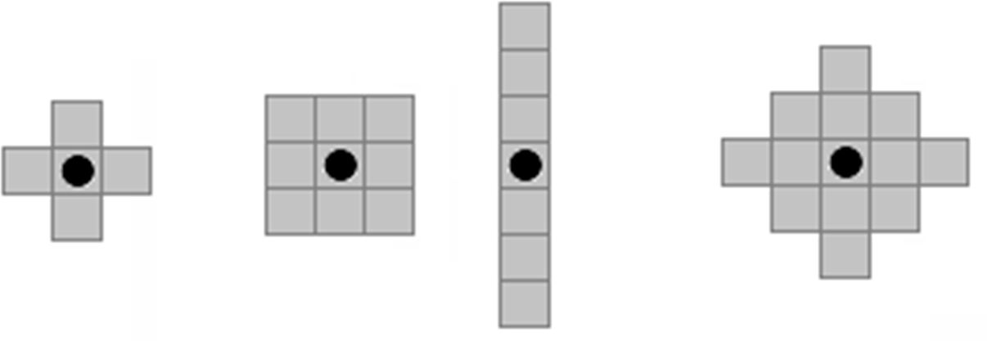
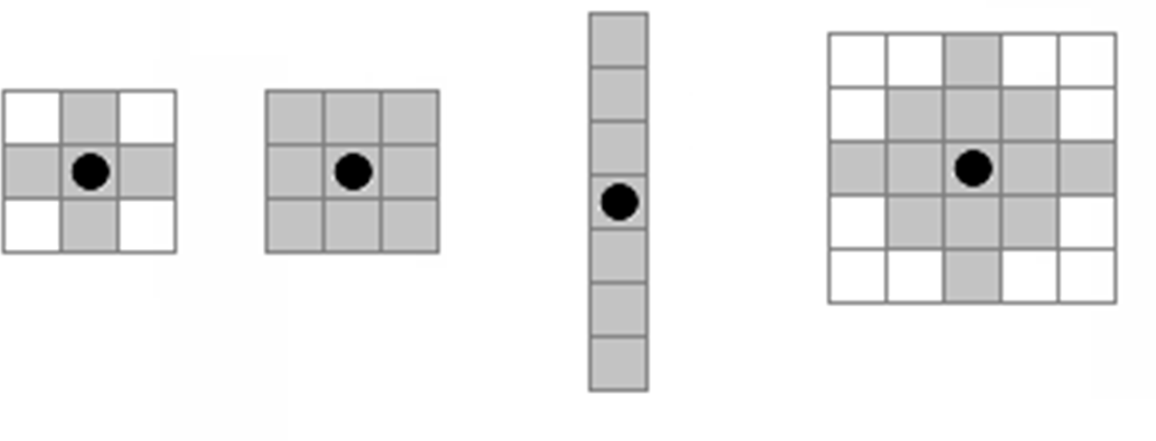
Structuring Elements
Examples
•
origin
Examples of structuring elements
Structuring elements Converted to rectangular arrays

Slide 8




Structuring Elements, Hits & Fits
Structuring Element
Fit: All pixels in the structuring element cover pixels in the object (A)
Hit: Any of the pixel in the structuring element covers an pixel in the object(B)
C – not a hit or a fit
B
A
C
All morphological processing operations are based on these simple ideas

Slide 9



Fitting & Hitting
0 | 0 | 0 | 0 | 0 | 0 | 0 | 0 | 0 | 0 | 0 | 0
0 | 0 |  |  |  | 0 | 0 |  |  |  | 0 | 0
0 | 0 |  | B |  | 1 | 1 |  | C |  | 0 | 0
0 | 1 |  |  |  | 1 | 1 |  |  |  | 0 | 0
0 | 1 | 1 | 1 | 1 | 1 | 1 | 1 | 0 | 0 | 0 | 0
0 | 0 | 1 | 1 | 1 | 1 | 1 | 1 | 0 | 0 | 0 | 0
0 | 0 | 1 | 1 | 1 | 1 |  |  |  | 0 | 0 | 0
0 | 0 | 1 | 1 | 1 | 1 |  | A |  | 1 | 1 | 0
0 | 0 | 0 | 0 | 0 | 1 |  |  |  | 1 | 1 | 0
0 | 0 | 0 | 0 | 0 | 0 | 0 | 0 | 0 | 0 | 0 | 0
1 | 1 | 1
1 | 1 | 1
1 | 1 | 1
0 1 1
1 1 1
1 1 1
0 0 0
0 0 0
1 0 0
Structuring Element 1
0 | 1 | 0
1 | 1 | 1
0 | 1 | 0
1 1 1
1 1 1
1 1 1
Structuring Element 2

Slide 10
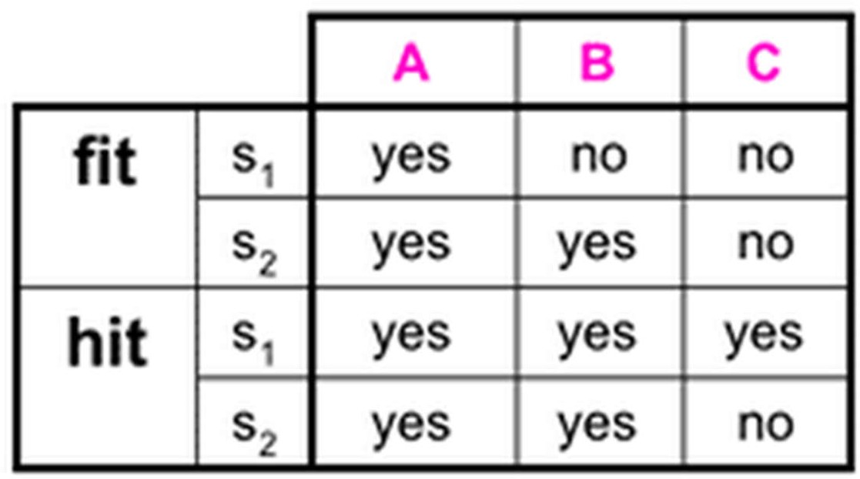
Fitting & Hitting

Slide 11
Fundamental Operations
Fundamentally morphological image processing is much like spatial filtering
The structuring element is moved across every pixel in the original image to give a pixel in a new processed image
The value of this new pixel depends on the operation performed
There are two basic morphological operations:
Erosion and Dilation

Slide 12
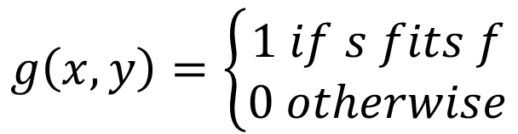
Erosion
Erosion of image f by structuring element s is given by f  s
The structuring element s is positioned with its origin at (x, y) and the new pixel value is determined using the rule:
$$g\left(x,y\right)=\left\{\begin{aligned}1 if s fits f \\ 0 otherwise\end{aligned}\right.$$

Slide 13
Example for Erosion
Input image
1 | 0 | 0 | 0 | 1 | 1 | 1 | 0 | 1 | 1
1 | 1 | 1
Structuring Element
Output Image
0

Slide 14
Example for Erosion
Input image
Structuring Element
1 | 0 | 0 | 0 | 1 | 1 | 1 | 0 | 1 | 1
1 | 1 | 1
Output Image
0 | 0

Slide 15
Example for Erosion
Input image
Structuring Element
1 | 0 | 0 | 0 | 1 | 1 | 1 | 0 | 1 | 1
1 | 1 | 1
Output Image
0 | 0 | 0

Slide 16
Example for Erosion
Input image
Structuring Element
1 | 0 | 0 | 0 | 1 | 1 | 1 | 0 | 1 | 1
1 | 1 | 1
Output Image
0 | 0 | 0 | 0

Slide 17
Example for Erosion
Input image
Structuring Element
1 | 0 | 0 | 0 | 1 | 1 | 1 | 0 | 1 | 1
1 | 1 | 1
Output Image
0 | 0 | 0 | 0 | 0

Slide 18
Example for Erosion
Input image
Structuring Element
1 | 0 | 0 | 0 | 1 | 1 | 1 | 0 | 1 | 1
1 | 1 | 1
Output Image
0 | 0 | 0 | 0 | 0 | 1

Slide 19
Example for Erosion
Input image
Structuring Element
1 | 0 | 0 | 0 | 1 | 1 | 1 | 0 | 1 | 1
1 | 1 | 1
Output Image
0 | 0 | 0 | 0 | 0 | 1 | 0

Slide 20
Example for Erosion
Input image
Structuring Element
1 | 0 | 0 | 0 | 1 | 1 | 1 | 0 | 1 | 1
1 | 1 | 1
Output Image
0 | 0 | 0 | 0 | 0 | 1 | 0 | 0

Slide 21
Example for Erosion
Input image
Structuring Element
1 | 0 | 0 | 0 | 1 | 1 | 1 | 0 | 1 | 1
1 | 1 | 1
Output Image
0 | 0 | 0 | 0 | 0 | 1 | 0 | 0 | 0

Slide 22
Example for Erosion
Input image
1 | 0 | 0 | 0 | 1 | 1 | 1 | 0 | 1 | 1
Structuring Element
1 1
Output Image
0 | 0 | 0 | 0 | 0 | 1 | 0 | 0 | 0 | 0

Slide 23

Erosion Example
Original Image
Processed Image With Eroded Pixels
Structuring Element

Slide 24


Erosion Example
Original Image
Processed Image
Structuring Element

Slide 25

Erosion Example
Original image
Erosion by 3*3 square structuring element
Erosion by 5*5 square structuring element

Slide 26
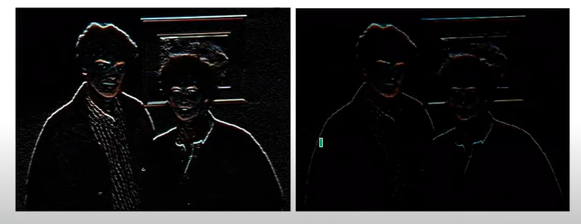
Erosion Example

Slide 27

Erosion Example
Original image
After erosion with a disc of radius 10
After erosion with a disc of
radius 5
After erosion with a disc of radius 20

Slide 28
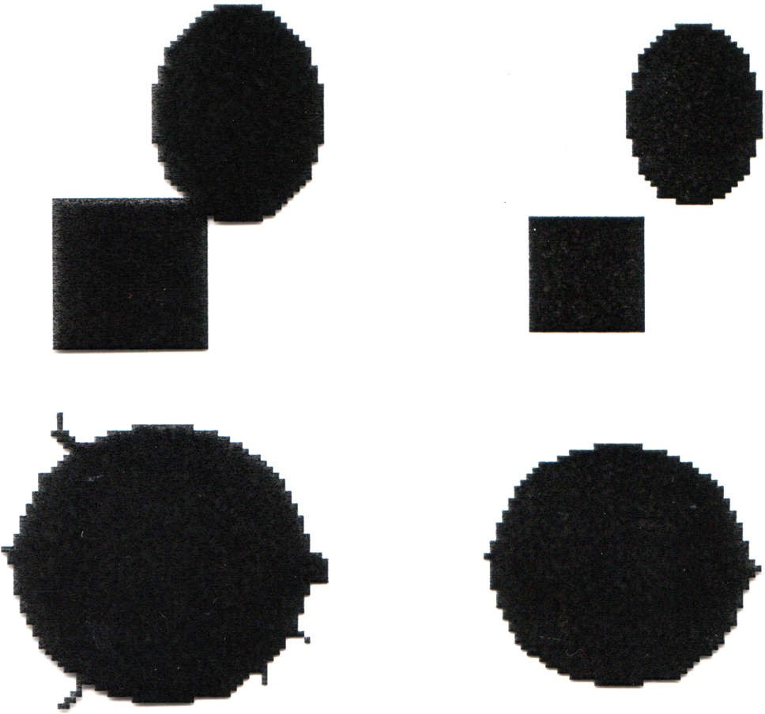
What is Erosion For?
Erosion can split apart joined objects
Erosion can strip away extrusions
Watch out: Erosion shrinks objects

Slide 29
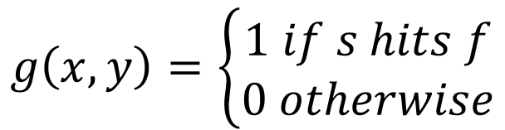
Dilation
Dilation of image f by structuring element s is given by f ⊕ s
The structuring element s is positioned with its origin at (x, y) and the new pixel value is determined using the rule:
$$g\left(x,y\right)=\left\{\begin{aligned}1 if s hits f \\ 0 otherwise\end{aligned}\right.$$

Slide 30
Example for Dilation
Input image
1 | 0 | 0 | 0 | 1 | 1 | 1 | 0 | 1 | 1
1 | 1 | 1
Structuring Element
Output Image
1

Slide 31
Example for Dilation
Input image
Structuring Element
1 | 0 | 0 | 0 | 1 | 1 | 1 | 0 | 1 | 1
1 | 1 | 1
Output Image
1 | 1

Slide 32
Example for Dilation
Input image
Structuring Element
1 | 0 | 0 | 0 | 1 | 1 | 1 | 0 | 1 | 1
1 | 1 | 1
Output Image
1 | 1 | 0

Slide 33
Example for Dilation
Input image
Structuring Element
1 | 0 | 0 | 0 | 1 | 1 | 1 | 0 | 1 | 1
1 | 1 | 1
Output Image
1 | 1 | 0 | 1

Slide 34
Example for Dilation
Input image
Structuring Element
1 | 0 | 0 | 0 | 1 | 1 | 1 | 0 | 1 | 1
1 | 1 | 1
Output Image
1 | 1 | 0 | 1 | 1

Slide 35
Example for Dilation
Input image
Structuring Element
1 | 0 | 0 | 0 | 1 | 1 | 1 | 0 | 1 | 1
1 | 1 | 1
Output Image
1 | 1 | 0 | 1 | 1 | 1

Slide 36
Example for Dilation
Input image
Structuring Element
1 | 0 | 0 | 0 | 1 | 1 | 1 | 0 | 1 | 1
1 | 1 | 1
Output Image
1 | 1 | 0 | 1 | 1 | 1 | 1

Slide 37
Example for Dilation
Input image
Structuring Element
1 | 0 | 0 | 0 | 1 | 1 | 1 | 0 | 1 | 1
1 | 1 | 1
Output Image
1 | 1 | 0 | 1 | 1 | 1 | 1 | 1

Slide 38
Example for Dilation
Input image
Structuring Element
1 | 0 | 0 | 0 | 1 | 1 | 1 | 0 | 1 | 1
1 | 1 | 1
Output Image
1 | 1 | 0 | 1 | 1 | 1 | 1 | 1 | 1

Slide 39
Example for Dilation
Input image
1 | 0 | 0 | 0 | 1 | 1 | 1 | 0 | 1 | 1
Structuring Element
1 1 1
Output Image
1 | 1 | 0 | 1 | 1 | 1 | 1 | 1 | 1 | 1

Slide 40
Dilation Example
Original Image
Processed Image With Eroded Pixels
Structuring Element

Slide 41


Dilation Example
Original Image
Processed Image With Dilated Pixels
Structuring Element

Slide 42

Dilation Example
Original image
Dilation by 3*3 square structuring element
Dilation by 5*5 square structuring element

Slide 43
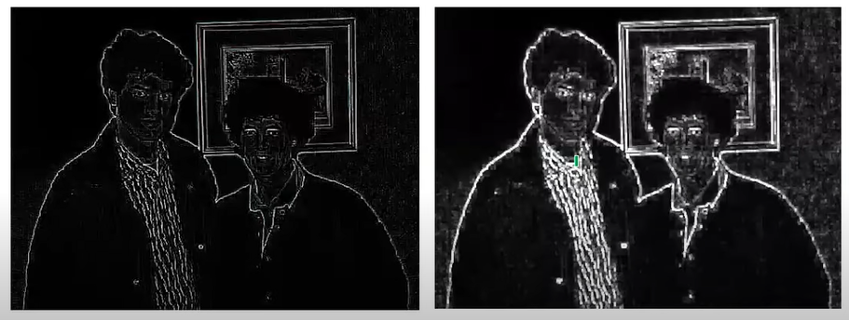
Dilation Example

Slide 44
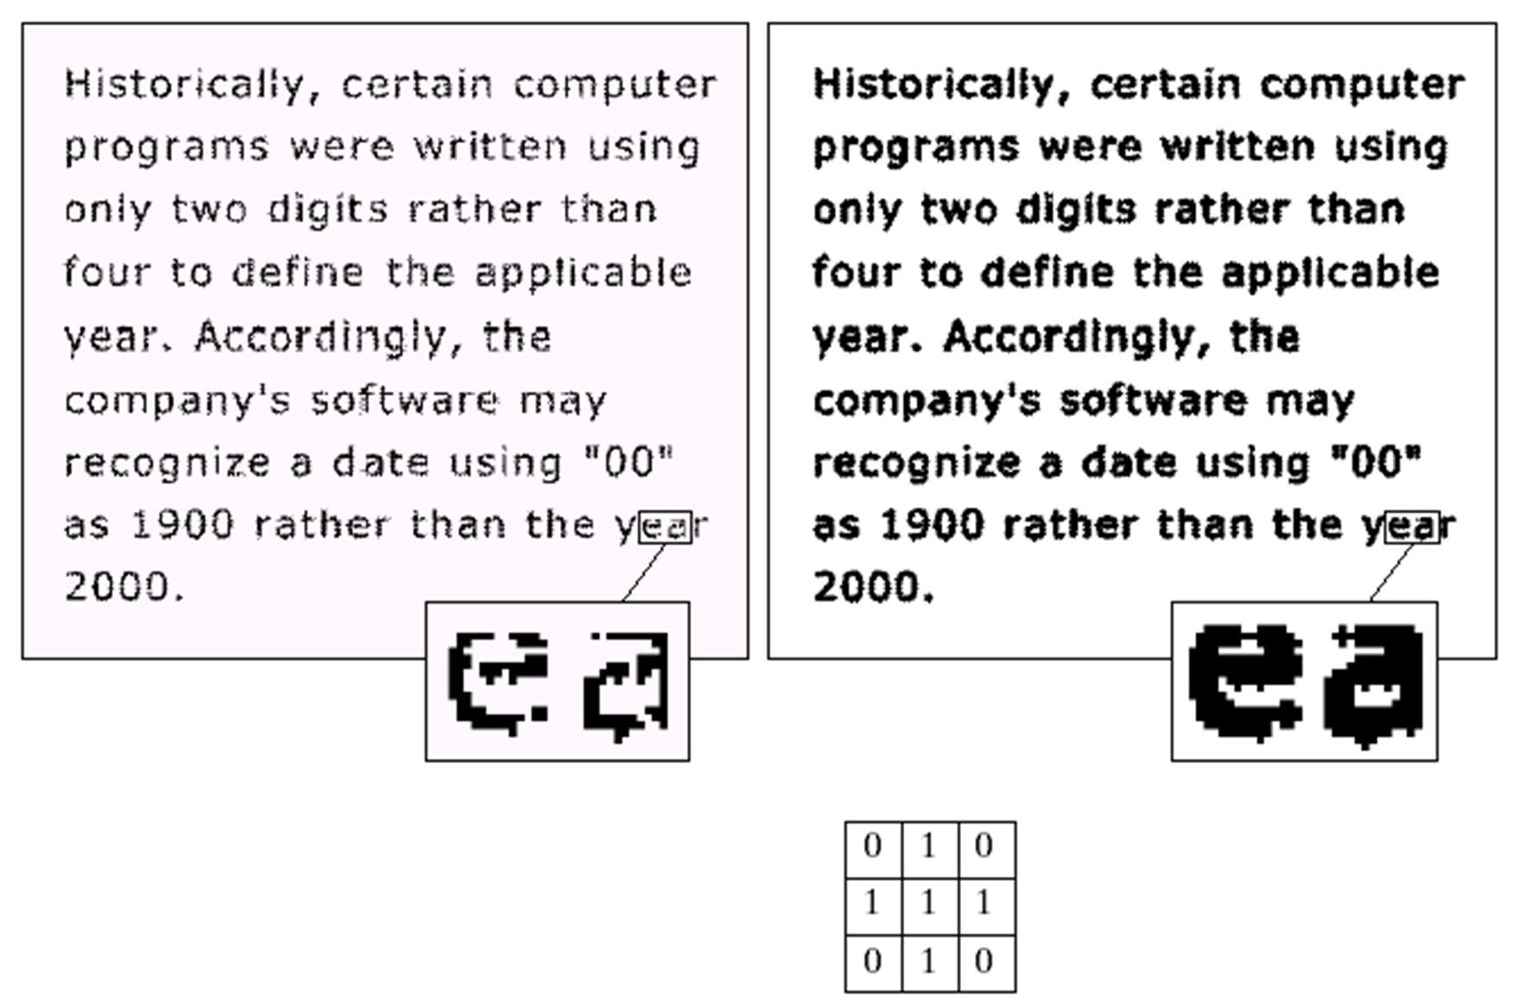
Dilation Example
Original image
After dilation
Structuring element

Slide 45
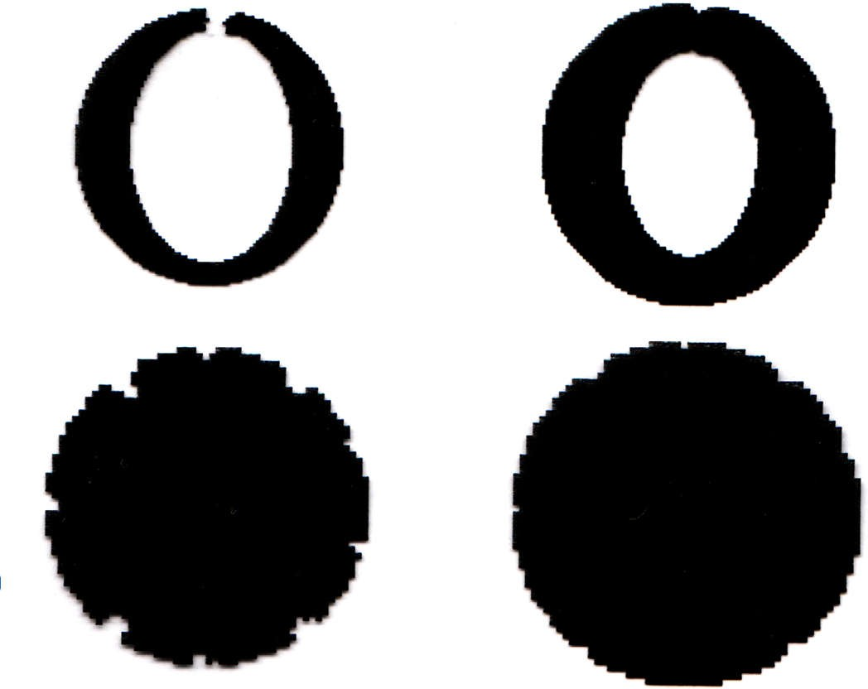
What Is Dilation For?
Dilation can repair breaks
Dilation can repair intrusions
Watch out: Dilation enlarges
objects

Slide 46
Dilation and Erosion
With dilation area of object increases and with erosion area decreases
Dilation removes noisy pixels belong to object region
Erosion removes the noise present in the background
Application of one method will compensate the other

Slide 47
Compound Operations
More interesting morphological operations can be performed by performing combinations of erosions and dilations
The most widely used of these compound operations are:
Opening
Closing

Slide 48
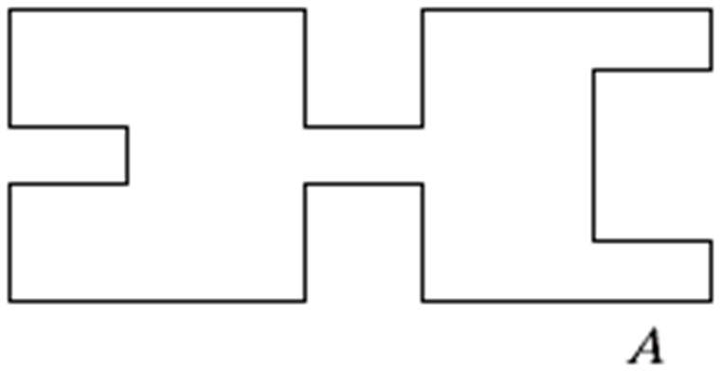

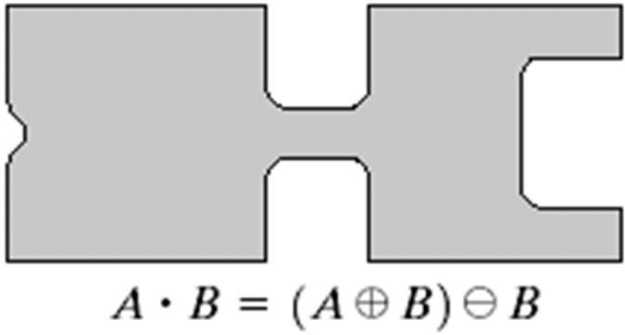
Closing
The closing of image f by structuring element s, denoted f • s is simply a dilation followed by an erosion
ƒ • s = (ƒ ⨁ s)s
Original shape
After dilation
After erosion (closing)
Note: a disc shaped structuring element is used

Slide 49


Closing Example
Original Image
Image After Closing

Slide 50
Closing Example
Original Image
Processed Image
Structuring Element

Slide 51


Closing Example
Closing operation with a 22 pixel disc
Closes small holes in the foreground

Slide 52
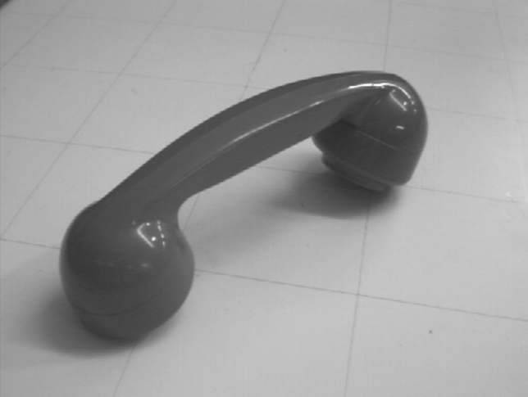


Closing Example
Threshold
Closing with disc of size 20
Thresholded
closed

Slide 53
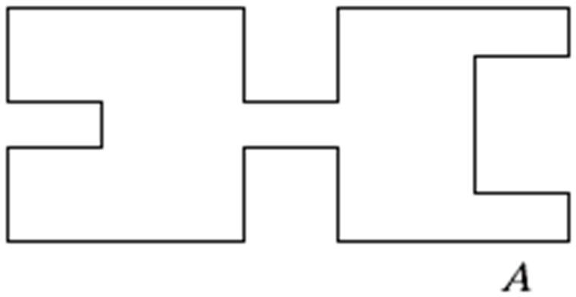
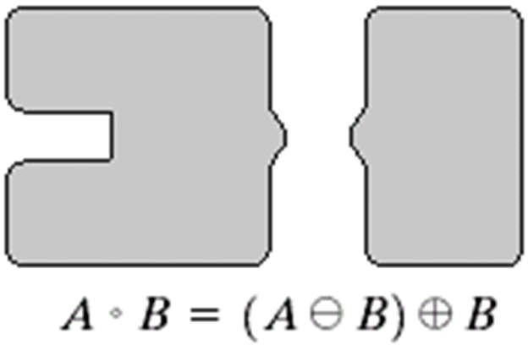
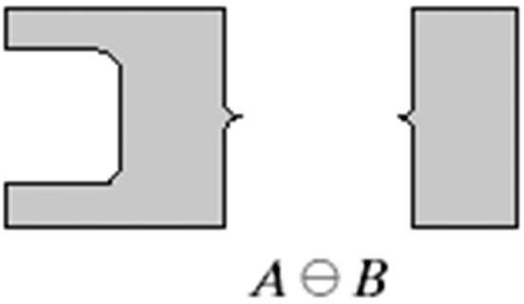
Opening
The opening of image f by structuring element s, denoted ƒ ○ s is simply an erosion followed by a dilation
ƒ ○ s = (ƒ ⊖ s)⨁s
Original shape After erosion
After dilation (opening)
Note: a disc shaped structuring element is used

Slide 54


Opening Example
Original Image
Image After Opening

Slide 55
Opening example
Original Image
Processed Image
Structuring Element

